Slide 1
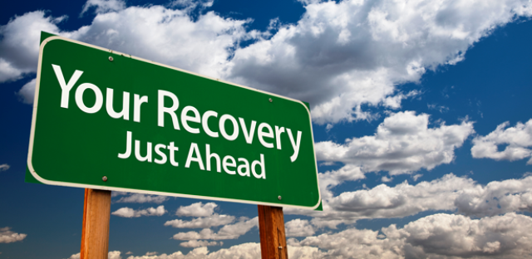
WELCOME TO C.A.R.E.
Character – Accountability –
Recovery – Encouragement

Slide 2
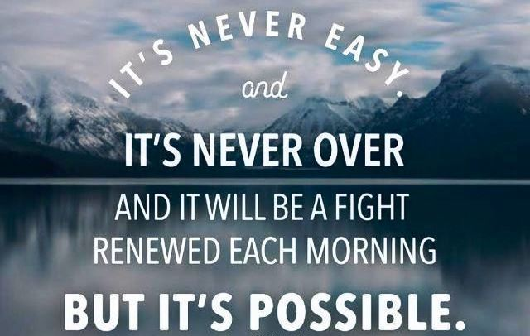

Slide 3
Don’t compare your progress with that of others. We all need our own time to travel our distance.


Slide 4
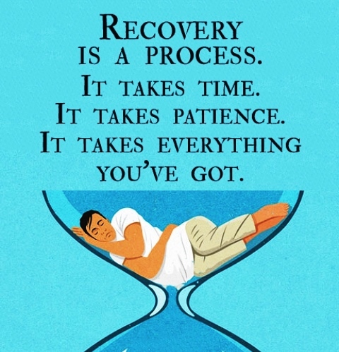

Slide 5
Keep in mind that there is no chemical or physical solution to a spiritual problem.


Slide 6
You were never created to live depressed, defeated, guilty, condemned, ashamed or unworthy. You were created to be victorious.

Slide 7
“God loved the people of this world so much that he gave his only Son, so that everyone who has faith in him will have eternal life and never really die. God did not send his Son into the world to condemn its people. He sent him to save them!” John 3:16-17 (CEV)


Slide 8
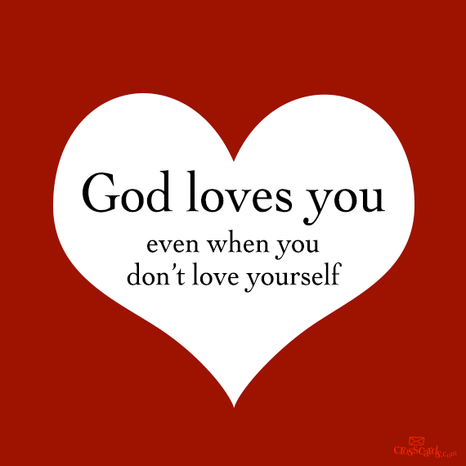
“God loves me so much that he gave his only Son, so that if I have faith in him I will have eternal life and never really die. God did not send his Son into the world to condemn me but to reclaim me.”

Slide 9
“Listen to God with a broken heart. He is not only the doctor who mends it, but also the father who wipes away the tears…. It is not true that everyone is special. It is true that everyone was once special and still possesses the ability to recover it.”

Slide 10
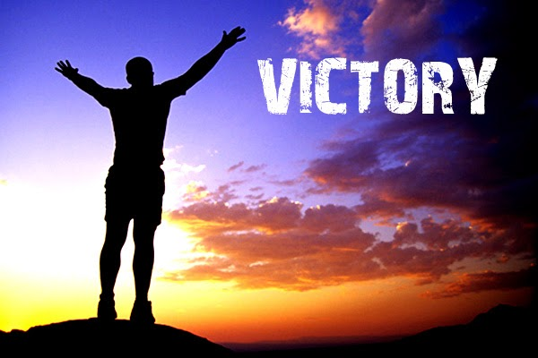
“I can do all this by the power of Christ. He gives me strength.” Philippians 4:13 (NIRV)

Slide 11
We admitted we were powerless over our addictions and dependencies – that our lives had become unmanageable.
Came to believe that only Almighty God could restore us to sanity.
Made a decision to turn our will and our lives over to the care of God through Jesus Christ our Lord and Savior.

Slide 12
4. Made a searching and fearless moral and ethical inventory of ourselves.
5. Admitted to God, to ourselves, and to another human being the exact nature of our harmful, sinful behaviors.
6. Were entirely ready to have the Holy Spirit remove all these sinful behaviors and resulting defects of character.

Slide 13
7. Humbly asked God to remove our sins and shortcomings.
8. Made a list of all persons we had sinned against, and became willing to make amends to them all.
9. Made direct amends to such people wherever possible, except when to do so would injure them or others.

Slide 14
10. Continued to take personal inventory and when we were wrong promptly admitted it.
11. Sought through prayer, study of the Scriptures, and meditation to improve our conscious contact with Almighty God, praying only for knowledge of His will for us and the power to carry that out.

Slide 15
12. Having had a spiritual awakening as the result of the Holy Spirit and these steps, we tried to carry this message to others with character defects, and to practice these principles in all our relationships.

Slide 16
God, grant me the serenity to accept the things I cannot change, courage to change the things I can, Living one day at a time; enjoying one moment at a time; accepting hardship as the pathway to peace. Taking, as he did, this sinful world as it is, not as I would have it. Trusting that he will make all things right if I surrender to his will; That I may be reasonably happy in this life,
and supremely happy with him forever in the next. Amen

Slide 17
We will share another meditation from someone in recovery followed by a time for personal sharing. After our sharing we will conclude with a time for prayer requests, pray, then recite the entire Serenity Prayer.

Slide 18
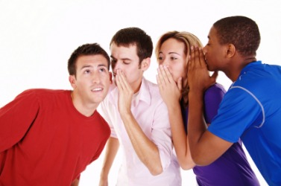
REMEMBER
Who you see here and what you hear here remains here.

